Slide 2
PIC18 Microcontroller Architecture
TE2015 Microcontroladores

Slide 3
OUTLINE
Tuesday, 16/August
Evolution of the PIC Microcontroller
Features of PIC18
Friday, 19/August
Special Function Register
Access Bank and Bank Select Register

Slide 4
Evolution of the PIC Microcontroller
TE2015 Microcontroladores

Slide 5
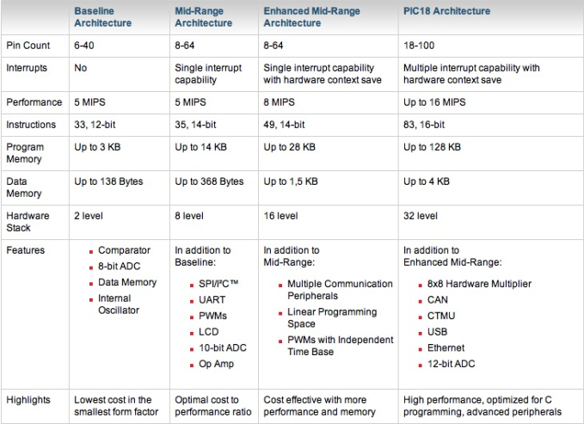
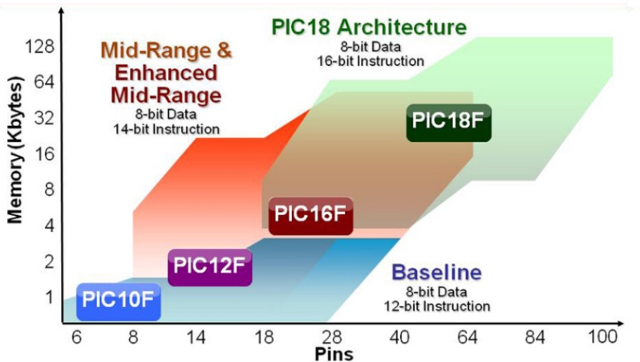
EVOLUTION OF PIC MICROCONTROLLER

Slide 6
Features of PIC18
TE2015 Microcontroladores

Slide 7
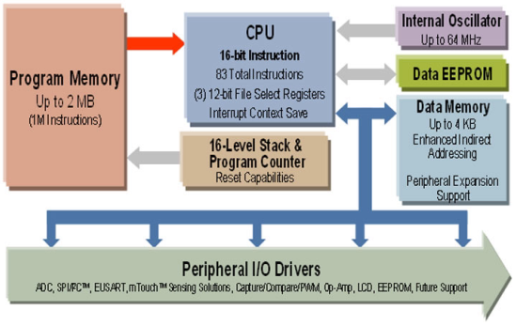
MEMORY ORGANIZATION
Program memory
Non-volatile memory that stores all the instructions we write
Data memory (RAM)
Volatile memory that keeps variables and runtime-generated data
Data memody (EEPROM)
Non-volatile with same functionality tan DATA RAM memory
Which architecture is that shown on the right?

Slide 8
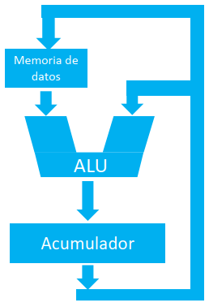
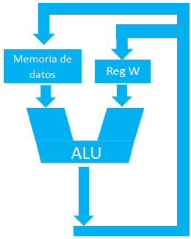
INSTRUCTION FORMAT
TRADITIONAL
The instruction set of PIC microcontrollers is Orthogonal
We can read from and write to all file registers, including SFRs
What makes the difference is where the WORKING (ACC) register is located
In traditional architectures, the result of any operation is always stored in ACC
In orthogonal architectures, the result of any operation can be stored in W or in data memory
W reg is always one operand of ALU
ORTHOGONAL

Slide 9
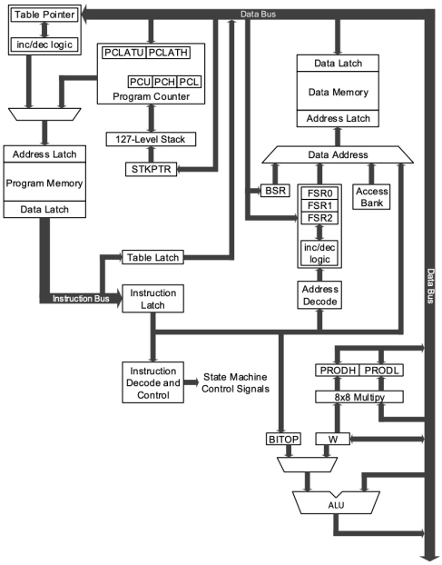
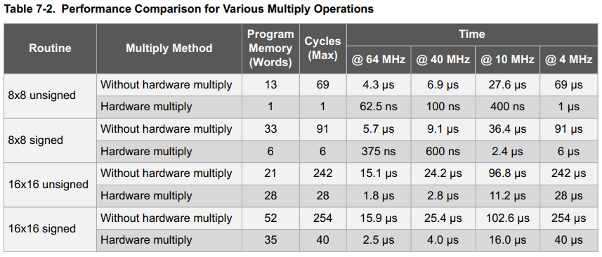
8 x 8 HARDWARE MULTIPLIER
The PIC18 family features an 8x8 hardware multiplier as part of the arithmetic-logic unit.
Carries out an unsigned multiplication and the 16-bit product is stored in the PROD register.
Hardware multiplier does not affect the STATUS register
Hardward multiplication allows to complete a full operation in one instruction cycle

Slide 10
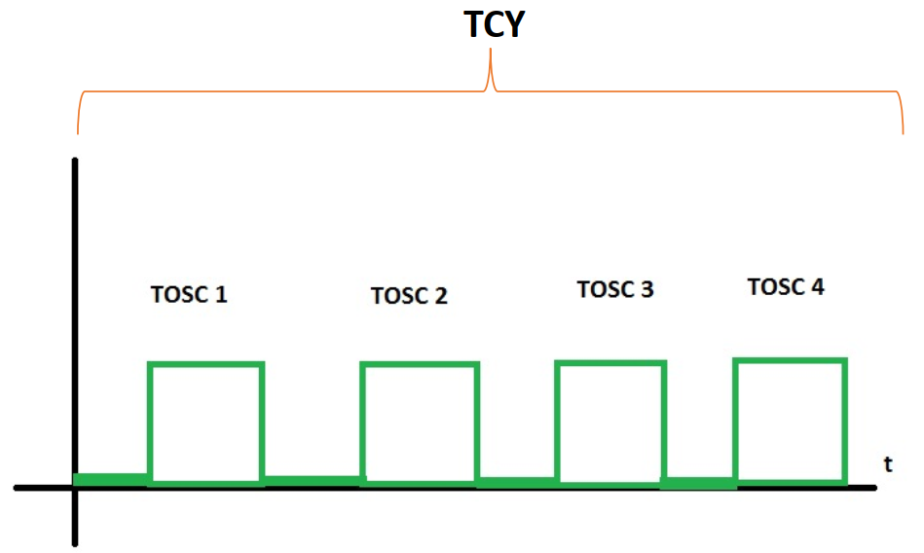
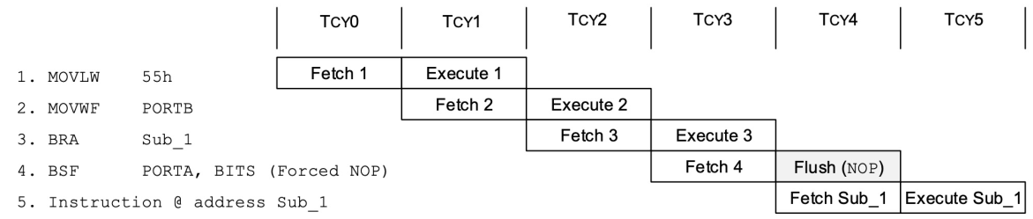
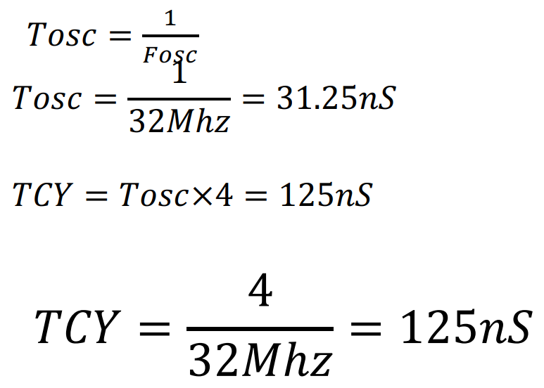
PIPELINING
As a pipelined processor, the CPU is able to carry out one instruction per cycle:
EXECUTION of one of the program instructions
FETCH of the following program instruction
The time it takes to execute a single-cycle instruction is called Cycle Time, TCY
One TCY comprises four clock cycles

Slide 11
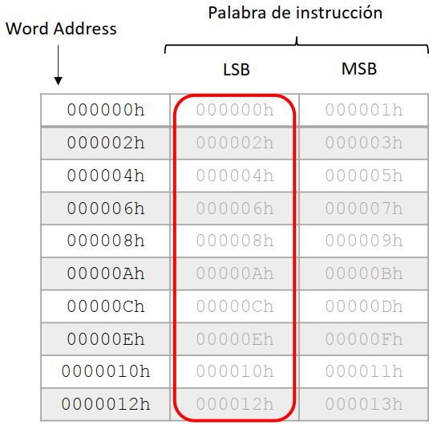
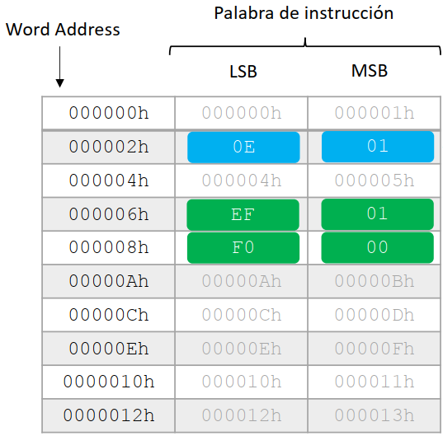

INSTRUCTIONS IN PROGRAM MEMORY
Program memory is addressed per byte
PC is incremented by 2
Instructions are stored in two bytes or four bytes
LSB is always stored on an even address
1 x TCY instructions are stored in two bytes
2 x TCY instructions are stored in four bytes

Slide 12
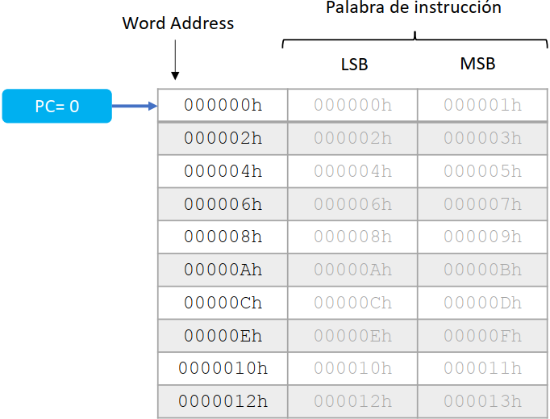
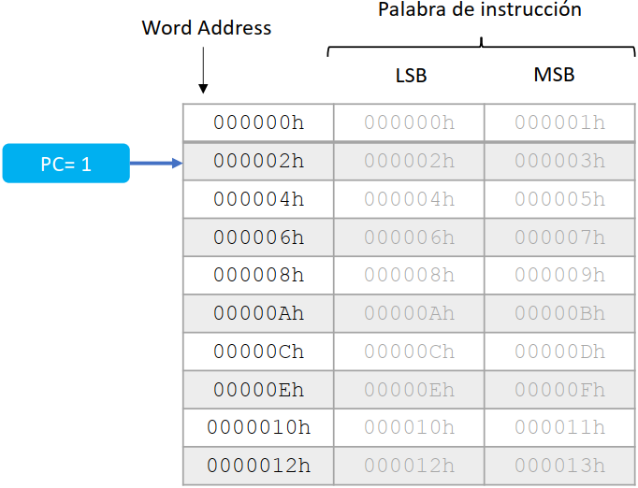
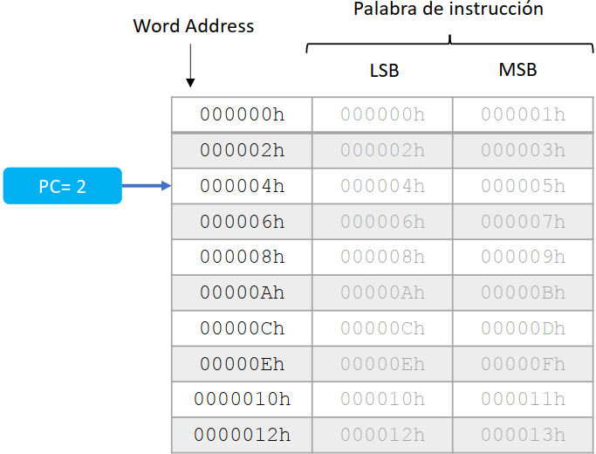

Slide 13
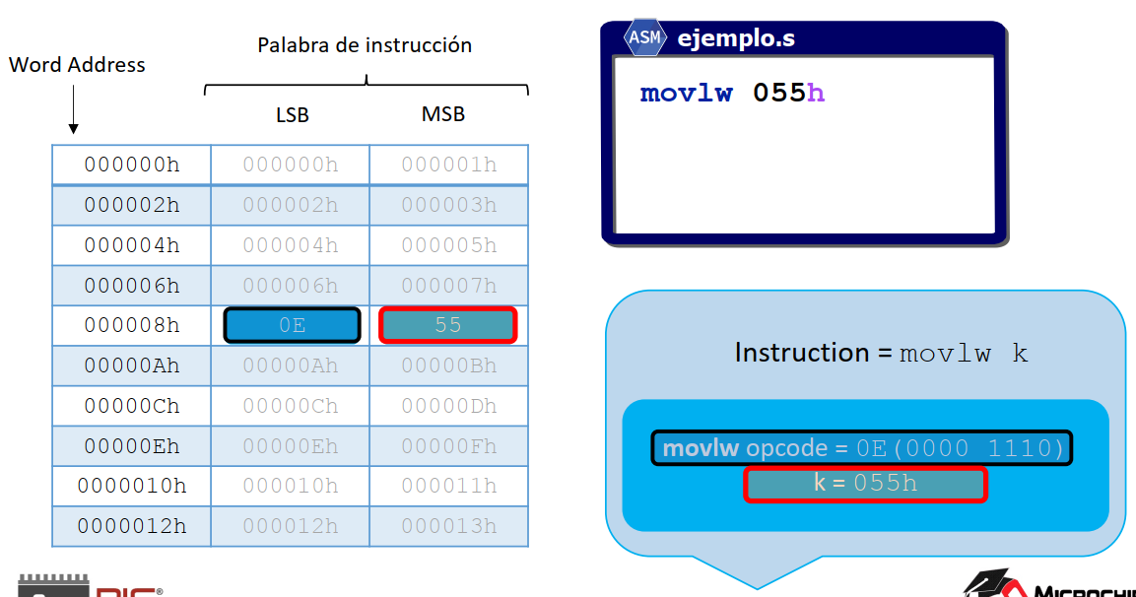
EXAMPLE

Slide 14
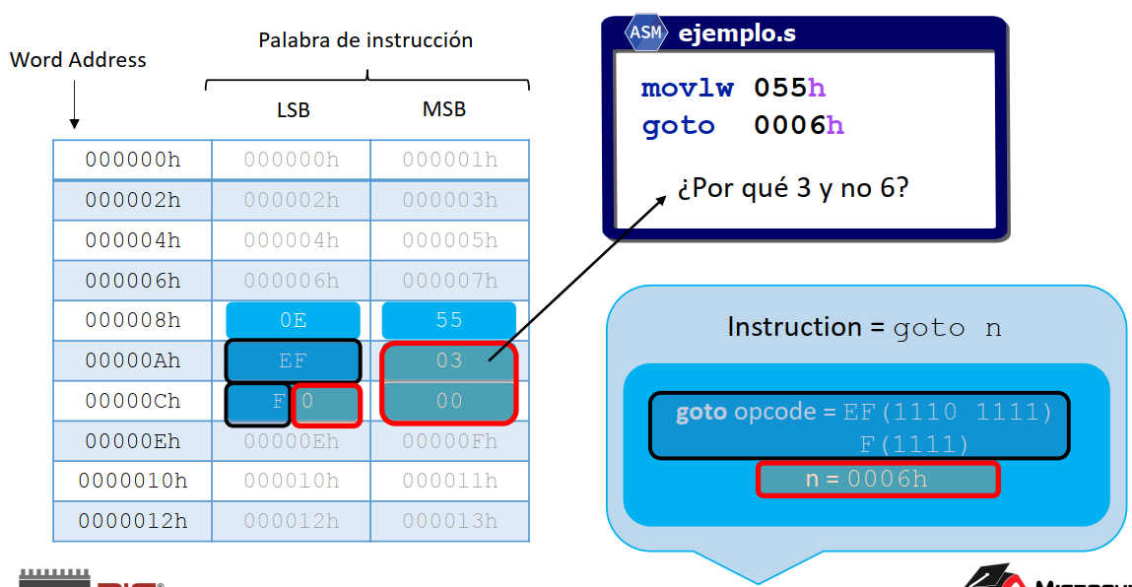
EXAMPLE
Why 3 and not 6?

Slide 15
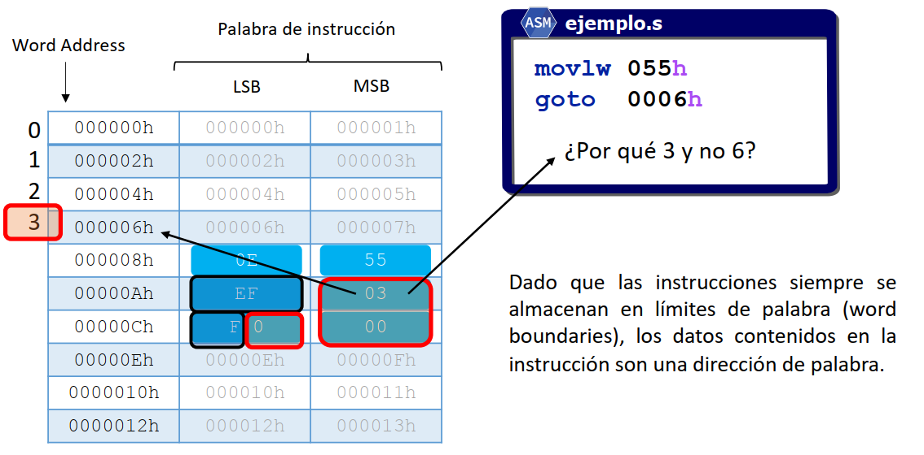
EXAMPLE
Why 3 and not 6?

Slide 16
PROGRAM COUNTER, PC[20:0]
Points to the address of next instruction
In PIC18 has a length of 21 bits, thus
2²¹ = 20,097,152 addresses
= 2 MBytes
Those 21 bits are split in three registers
Contents of PCLATH and PCLATU are transfered to PCH and PCU by any operation that writes on PCL
Conversely, contents of PCLATH and PCLATU are transfered to PCH and PCU by any operation that writes on PCL
LSB of PC is fixed to 0 and increments are by 2 to keep PC aligned to full instruction addresses
PC=0000b
PC=0010b
PC=0100b
REG | MEANING | RANGE | ACCESS
PCL | Low byte | PC[7:0] | R/W
PCH | High byte | PC[15:8] | PCLATH
PCU | Upper byte | PC[20:16] | PCLATU
PC=0110b

Slide 17
Special Function Registers
TE2015 Microcontroladores

Slide 18
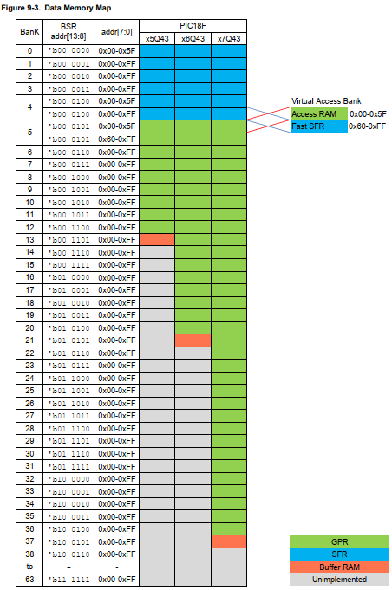

RAM DATA MEMORY
12-bit addresses
2¹² = 4096 addresses = 4 KBytes
It holds
Special Function Registers (SFRs)
Control and status of µC
Control and configuration of peripherals
General Function Registers (GPRs)
To store user data and variables
For fast memory access, we bank the memory
SFRs
GPRs
PIC18F57Q43
DATA MEMORY
SFRs
GPRs

Slide 19
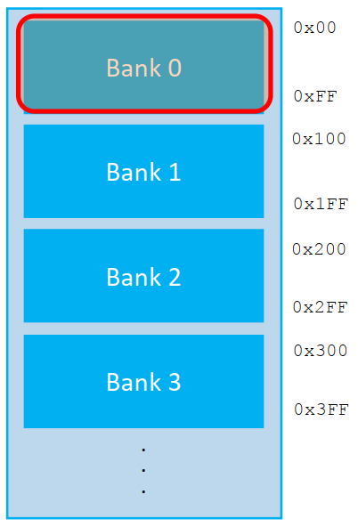
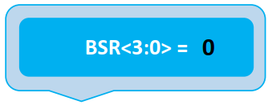
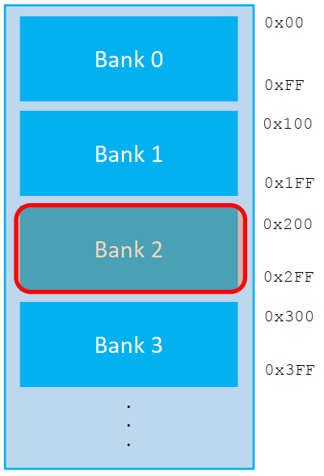
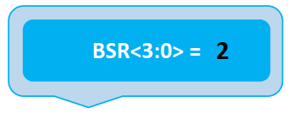
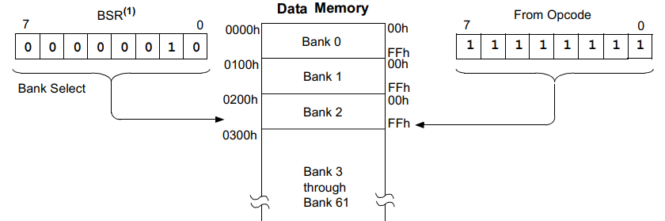
BANK SELECT REGISTER, BSR
We can access every memory location by using its full 12-bit address
This is called Access Bank
Or we can use a register called Bank Select Register, BSR
We just need the 4 most significant bits of an address
The instruction includes the remaining 8 bits
To load those 4 bits to BSR, we use MOVLB

Slide 20
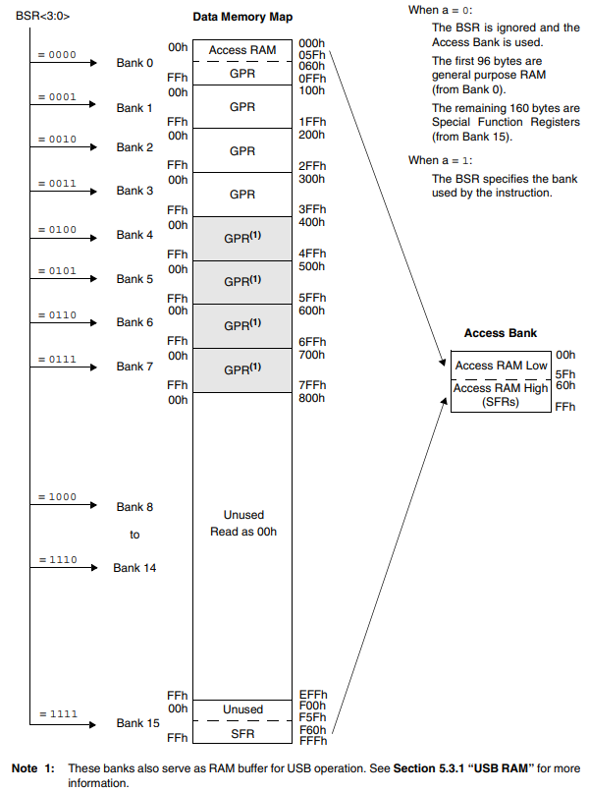
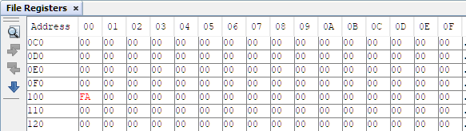
EXAMPLE WITH PIC18F4550
Open PIC18F4550 datasheet and go to section 5.3 Data Memory Organization.
How many data memory banks are available for the 4550 device? 15 banks
How many of these are implemented and how many are not implemented? 9 are implemented and 7 are not implemented
What is the size of each bank (in bytes)? 256 bytes
What is the address range for Bank 3? 0x300 to 0x3FF
Use MPLAB X to simulate data load in PIC18F4550 through the Bank Select Register:
Load 0xFA on address 0x100 in Bank 1
Load 9₁₀ on address 0x200 in Bank 2
Load 0xA0 on address 0x345
Load 156₁₀ ton address 0x710
What happens if we specify an address but do not switch to its corresponding bank?

Slide 21
EXAMPLE WITH PIC18F4550
Open PIC18F4550 datasheet and go to section 5.3 Data Memory Organization.
How many data memory banks are available for the 4550 device? 15 banks
How many of these are implemented and how many are not implemented? 9 are implemented and 7 are not implemented
What is the size of each bank (in bytes)? 256 bytes
What is the address range for Bank 3? 0x300 to 0x3FF
Use MPLAB X to simulate data load in PIC18F4550 through the Bank Select Register:
Load 0xFA on address 0x100 in Bank 1
Load 9₁₀ on address 0x200 in Bank 2
Load 0xA0 on address 0x345
Load 156₁₀ ton address 0x710
What happens if we specify an address but do not switch to its corresponding bank?

Slide 22
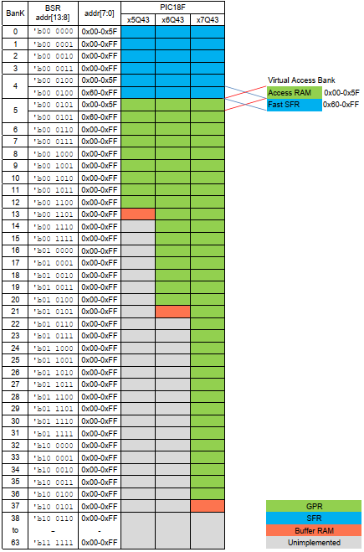
EXERCISE WITH PIC18F57Q43
Open PIC18F57Q43 datasheet and go to section 9.4 Data Memory Organization
How many data memory banks are available for the x7Q43 device? 64 banks
How many of these are implemented and how many are not implemented? 38 are implemented and 25 are not implemented
What is the size of each bank (in bytes)? 256 bytes
What is the address range for Bank 5? 0x500 to 0x5FF
Use MPLAB X to simulate data load in PIC18F57Q43 through the Bank Select Register
Load 0xAE to address 0x100 in Bank 1
Load 254₁₀ to address 0x200 in Bank 2
Load 0x03 to address 0x345
Load 58₁₀ to address 0x2FF
What happens if we specify an address but do not switch to the corresponding bank?
Test this by loading a 0x50 into address 0x010 but staying in the same bank than the previous instruction (Bank 2)

Slide 23
ACCESS BANK
The BSR is useful to address data memory; however, care must be taken when switching banks to make sure you write/read the correct memory location
CODE
1
a=0
1
This is why we have the Access Bank
allows to access a memory block bypassing the BSR However, this is limited to: (for 18F57Q43)
Access RAM: first 96 bytes (0x00 – 0x5F) of Bank 5
Special SFRs: last 160 bytes (0x60 – 0xFF) of Bank 4
Instructions with Access RAM capabilities include parameter “a” as one of its bit arguments:
a = 1 uses BSR and an 8-bit included with the opcode
a = 0 ignores BSR and uses map address of Access Bank
Access Bank addressing allows to make operations with data memory in one instruction since no BSR updating is required
a=1
BSR
2
p

Slide 24
MPLAB EXERCISE WITH PIC18F57Q43
Use MPLAB X debugger to access data memory of PIC18F57Q43 through Access Bank
Load 0x68 to address 0x100 in Bank 1
Load 194₁₀ to address 0x200 in Bank 2
Load 0x89 to address 0x345
Load 58₁₀ to address 0x2FF
PROCESSOR 18F57Q43
#include <xc.inc>
PSECT resetVec, class=CODE, reloc=2
resetVec:
goto main
PSECT code
main:
; YOUR CODE GOES HERE
end resetVec

Slide 25
Hardware Stack
TE2015 Microcontroladores

Slide 26
HARDWARE STACK
PC to STACK
CALL
RCALL
Interrupt
Hardware stack is a memory we use to store return addresses after interrupts and subroutine calls
PIC18 family accounts for 31 stack levels; however, PIC18F57Q43 implements 127 stack levels
Each time a CALL or RCALL instruction is executed, or an interrupt is generated, the value on PC is transferred to the Stack
Then, the value from the Stack to the PC is transferred back with instructions RETURN, RETLW and RETFIE
STACK to PC
RETURN
RETLW
RETFIE

Slide 27
HARDWARE STACK
 | loop:
0x00 | bcf PORTD, 0
0x01 | call delay
0x02 | bsf PORTD, 0
0x03 | call delay
0x04 | goto loop
 | delay:
0x0A | …
0x0B | …
0x0C | …
0x0D | return
STACK
PC

Slide 28
HARDWARE STACK
 | loop:
0x00 | bcf PORTD, 0
0x01 | call delay
0x02 | bsf PORTD, 0
0x03 | call delay
0x04 | goto loop
 | delay:
0x0A | …
0x0B | …
0x0C | …
0x0D | return
STACK
0x02
PC

Slide 29
HARDWARE STACK
 | loop:
0x00 | bcf PORTD, 0
0x01 | call delay
0x02 | bsf PORTD, 0
0x03 | call delay
0x04 | goto loop
 | delay:
0x0A | …
0x0B | …
0x0C | …
0x0D | return
STACK
0x02
PC

Slide 30
HARDWARE STACK
 | loop:
0x00 | bcf PORTD, 0
0x01 | call delay
0x02 | bsf PORTD, 0
0x03 | call delay
0x04 | goto loop
 | delay:
0x0A | …
0x0B | …
0x0C | …
0x0D | return
STACK
0x02
PC

Slide 31
HARDWARE STACK
 | loop:
0x00 | bcf PORTD, 0
0x01 | call delay
0x02 | bsf PORTD, 0
0x03 | call delay
0x04 | goto loop
 | delay:
0x0A | …
0x0B | …
0x0C | …
0x0D | return
STACK
0x02
PC

Slide 32
HARDWARE STACK
 | loop:
0x00 | bcf PORTD, 0
0x01 | call delay
0x02 | bsf PORTD, 0
0x03 | call delay
0x04 | goto loop
 | delay:
0x0A | …
0x0B | …
0x0C | …
0x0D | return
STACK
0x02
PC

Slide 33
HARDWARE STACK
 | loop:
0x00 | bcf PORTD, 0
0x01 | call delay
0x02 | bsf PORTD, 0
0x03 | call delay
0x04 | goto loop
 | delay:
0x0A | …
0x0B | …
0x0C | …
0x0D | return
STACK
0x02
PC

Slide 34
HARDWARE STACK
 | loop:
0x00 | bcf PORTD, 0
0x01 | call delay
0x02 | bsf PORTD, 0
0x03 | call delay
0x04 | goto loop
 | delay:
0x0A | …
0x0B | …
0x0C | …
0x0D | return
STACK
0x02
PC

Slide 35
HARDWARE STACK
 | loop:
0x00 | bcf PORTD, 0
0x01 | call delay
0x02 | bsf PORTD, 0
0x03 | call delay
0x04 | goto loop
 | delay:
0x0A | …
0x0B | …
0x0C | …
0x0D | return
STACK
PC

